Slide 1
Sytem Information Administration Selling and Buying at Maju Mapan Store
Paskalis Tunggal (26406098)
Supervisor :
Kartika Gunadi, M.T.
Alexander Setiawan, M.T.

Slide 2
Requirement
Analysis
Design
Implementation
Closing
Background
Objective
Research Question
Scope

Slide 3
Requirement
Analysis
Design
Implementation
Closing
Old System
Analysis Requirement System

Slide 4
Context Diagram
Requirement
Analysis
Design
Implementation
Closing

Slide 5
Data Flow Diagram Level 0
Requirement
Analysis
Design
Implementation
Closing

Slide 6
Data Flow Diagram Level 1 Sales
Requirement
Analysis
Design
Implementation
Closing

Slide 7
Data Flow Diagram Level 1 Purchase
Requirement
Analysis
Design
Implementation
Closing

Slide 8
Entity Relationship Diagram – Concept.
Requirement
Analysis
Design
Implementation
Closing
Erd concept

Slide 9
Entity Relationship Diagram – Physic.
Requirement
Analysis
Design
Implementation
Closing
ERD Physic

Slide 10
Setting
Requirement
Analysis
Design
Implementation
Closing
Programming was using Microsoft Visual Basic 2005, and the database was using Microsoft SQL Server 2005.

Slide 11
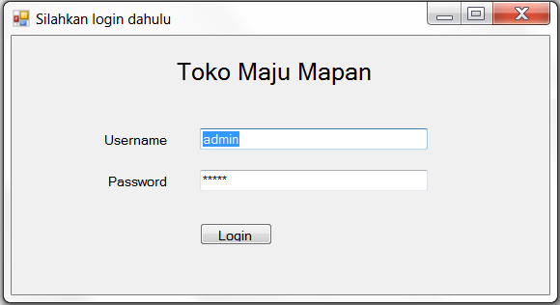
Screenshot
Requirement
Analysis
Design
Implementation
Closing

Slide 12
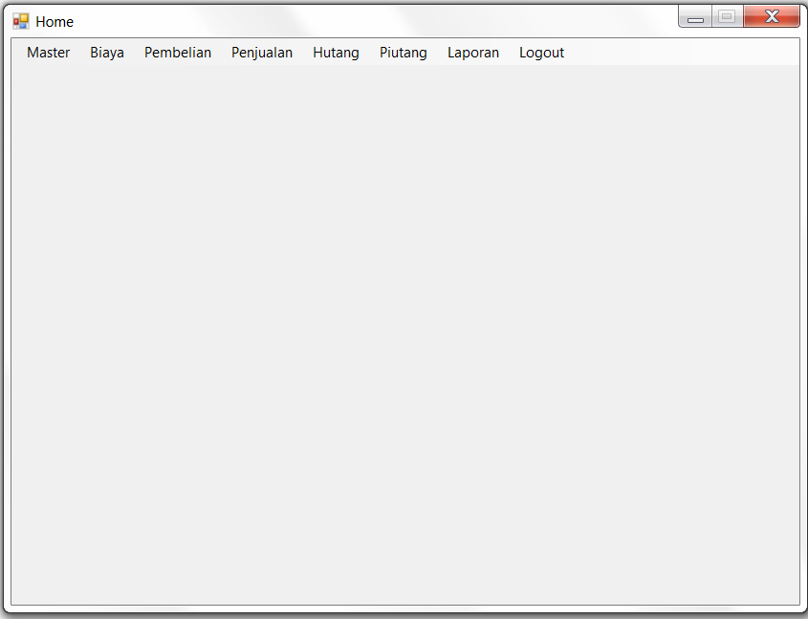
Screenshot (Cont.)
Requirement
Analysis
Design
Implementation
Closing

Slide 13
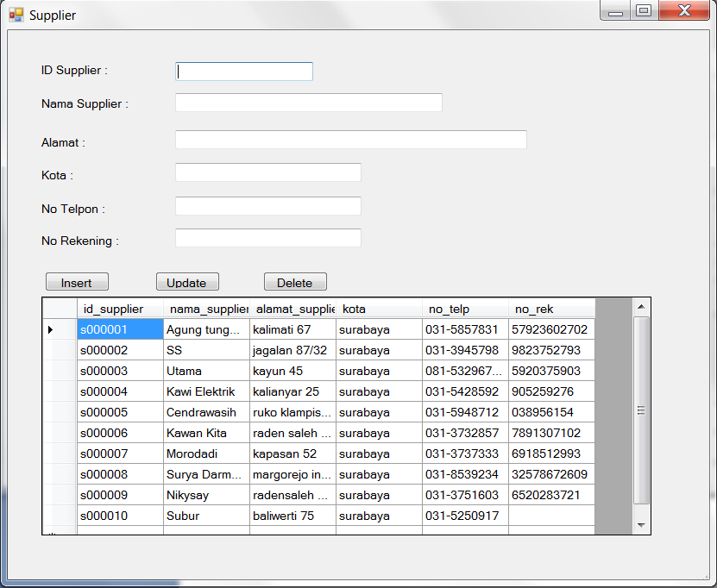
Screenshot (Cont.)
Requirement
Analysis
Design
Implementation
Closing

Slide 14
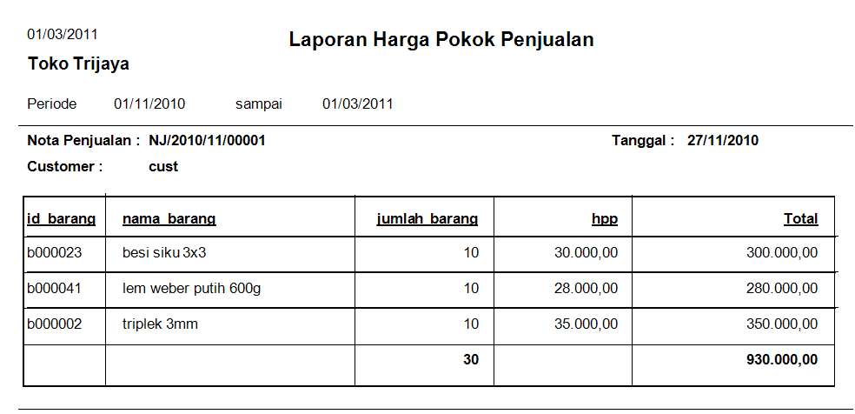
Screenshot (Cont.)
Requirement
Analysis
Design
Implementation
Closing

Slide 15
Conclusion
Requirement
Analysis
Design
Implementation
Closing
Can help the company to record sales, purchases and inventory and accounts payable.
Can help companies analyze the report.

Slide 16
Suggestion
Requirement
Analysis
Design
Implementation
Closing
Developed a complete accounting information systems.

