Slide 1
DESIGN and IMPLEMENTATION DIGITAL WHITEBOARD with WIIMOTE
Author :
Ng Thomas ( 26406034 )
Under the Guidance of:
Iwan Njoto Sandjaja, MSCS.
Rudy Adipranata, M.Eng.
Notes:
Good afternoon/ morning ladies and gentlemen, today I want to present my thesis about DESIGN and IMPLEMENTATION DIGITAL WHITEBOARD with WIIMOTE
Under guidance of Mr. Iwan Njoto Sandjaja and Mr. Rudy Adipranata.
First let’s start with the background

Slide 2
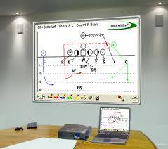

BACKGROUND
Users can’t write freely like using a pen or whiteboard during presentation with computer
Notes:
Users can’t write freely like using a pen or whiteboard during presentation with computer
In the past people usually use whiteboard or blackboard to present their presentation
But right now, people usually use computer and projector as presentation tools.
Although computer technology has a weakness, we can’t draw or write anything on projector screen like we did with the whiteboard.
Off course Mouse, can help us to provide that, but it will be a lot better if we can write directly on the screen.

Slide 3
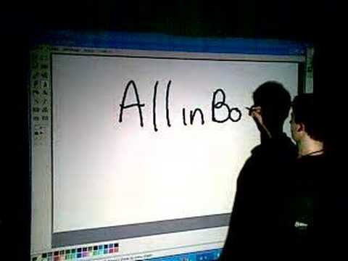
MAIN GOAL
To create an application where users can write and draw to help presentation on projector screen with Wiimote technology.
Notes:
My main goal is To create an application where users can write and draw to help presentation on projector screen with Wiimote technology. Well you can see the picture, a man’s writting on the projector screen.

Slide 4
PROBLEM STATEMENT
How to convert an infrared sensor that was captured become a coordinat point.
How to connect bluetooth between Wiimote and computer.
How to simulate cursor movement and functions from input that comes from Wiimote.
How to make an simple application vector graphic paint that can be used for writting, drawing and watching images.
Notes:
About the problem statement,
Number 1. How to convert an infrared sensor that was captured become a coordinat point.
Number 2. How to connect bluetooth between Wiimote and computer.
Number 3. How to simulate cursor movement and functions from input that comes from Wiimote. So it means how to make a mouse simulation .
Number 4. How to make an simple application vector graphic paint that can be used for writting, drawing and watching images.

Slide 5
SCOPE and LIMITATIONS
Hardware
Using a Wiimote as infrared receiver and an infrared pen as infrared sensor.
Infrared sensor from infrared pen must be captured directly and must not be blocked.
Distance between Wiimote and infrared pen up to 5 meter or inside the infrared range.
Distance between Wiimote and computer inside the bluetooth range.
The sensor must be captured from infrared pen
Wiimote placement right in front of the center of the screen.
Wiimote direction perpendicular to the screen.
Notes:
Follow the text
* 2. Infrared sensor from infrared pen must be captured directly and must not be blocked, like hands, pen, and many more.
* 5. The sensor must be captured from infrared pen, sometimes in the room can provide another infrared sensor like lamps, candle, sun, and many more.

Slide 6
SCOPE and LIMITATIONS (cont)
Software
System can only process 2 input sensor from Wiimote
Wiimote and computer is connected by bluetooth
Using SVG as format save data for drawing two-dimensional image vector.
First sensor that was captured become mouse replacement to move and click cursor mouse.
If there are 2nd captured sensor, then there will be new features like rotate, scroll and zoom.
Using operating system Windows XP
Using C# developer with .NET Framework v2.0
Notes:
Follow the text
*5 If there are 2nd captured sensor, then there will be new features like rotate, scroll and zoom. Well with 2 sensor together that means we can do multitouch. Multitouch means you can do some features with 2 touch / 2 sensor . Usually we can see it in mac products.
*6 Using operating system Windows XP, but I’ve tried another operating system like vista and 7 and they work correctly

Slide 7
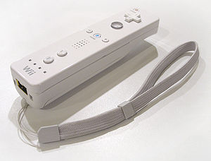
WIIMOTE
Used as infrared camera to capture infrared sensor
Has resolution camera 1024 x 768
Has vertical angle 33 degrees and horizontal angle 23 degrees
Has 4 slots to save position sensors.
Notes:
Now about the Wiimote, Wiimote is a controller for game console Wii.
It can sense movement, has 6 buttons, infrared camera and bluetooth.
In this project, the most important part in this Wiimote is infrared camera.
The infrared camera is used to capture the infrared sensor.
The camera has resolution 1024 times 768.
The camera has angle vertical angle 33 degrees and horizontal angle 23 degrees.
Inside the wiimote has 4 slots to save position sensor.
For example, if the first sensor is captured, then the position of the sensor will be save in first slot.
If another sensor is captured, then it will be save in second slot.
So that how it works.

Slide 8
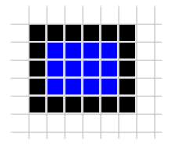
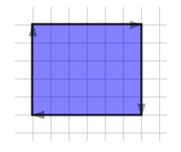
VECTOR GRAPHIC
Is a graphic that drawing geometric shapes.
It’s different with bitmap graphic.
Notes:
Vector graphic is a graphic that drawing geometric shapes.
Geometric is come from Geometry that means part of mathematics concerned with questions of size, shape, relative position of figures, and the properties of space.
So basicly, we need to know what is the size, the shape, before we draw a vector graphic.
It’s different with bitmap graphic.
Bitmap graphic use pixel to draw.
As you can see in this picture. But the vector graphic use position, like positions at the corners, what kind it shape, and many more.

Slide 9
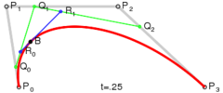
BEZIER CURVES
Used in computer graphics to model smooth curves
There are control points to control curve shape
Variable t is used for length of B(t) or the curve from P0 to P3 with value 0 to 1
Notes:
BezierCurve is used in computer graphics to model smooth curves
There are control points to control curve shape.
Well as you can in this picture, this is quadratic bezier curve. I’ll use that to draw curve in my paint application.
There are 4 control points, p0,p1,p2,and p3.
P0 is the start point and p3 is the end point.
P1 and p2 are points to help shape the curve.
And there are variable t is used for length of B(t) or the curve from P0 to P1 with value 0 to 1.
You can see the formula of the quadratic bezier curve is use to find position curve from control point.
From this formula we can make aninvers formula to find control points from position curve.

Slide 10
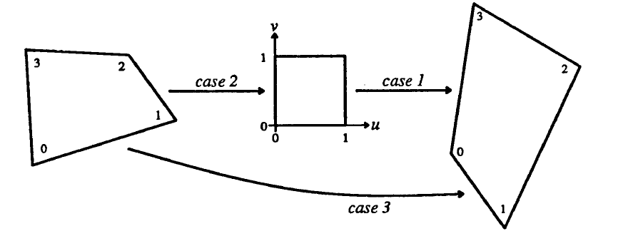
PROJECTIVE MAPPING
Notes:
The projective mapping
First lets see the picture.
Projective mapping is used to make a quadrilateral shape become a square shape with interval 0 to 1.
Or it can also make a square become a quadrilateral or quadrialter to quadrilateral.

Slide 11
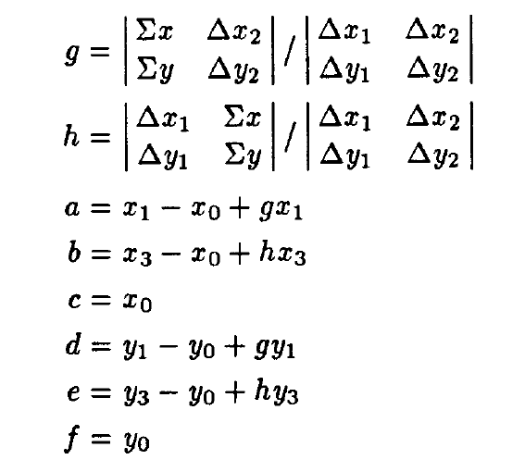
PROJECTIVE MAPPING (cont)
Quadrilateral to rectangle
Notes:
This is the formula of projective mapping
It’s from quadrilateral to rectangle.
The value of a to g are matrix value for mapping
And the x and y is the position sensor

Slide 12
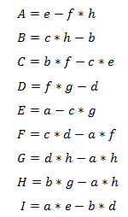
PROJECTIVE MAPPING (cont)
Rectangle to quadrilateral
The formula is an inverse formula projective mapping quadrilateral o rectangle.
Notes:
This is projective mapping from rectangle to quadrilateral is the inverse of the previous formula.
This formula needs value from the previous formula to find the result.
We need those result for mapping.

Slide 13

PROJECTIVE MAPPING (cont)
How to use it ?
Reference materials from “Fundamental of Texture Mapping and Image Warping” by Paul S. Heckbert
Notes:
How to use it,
Well as you can see, x and y represent as position sensor
And u and v represent as position cursor or mouse.
So we just need to multiply and divide thos value to find position cursor

Slide 14
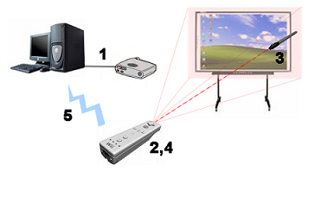
HARDWARE DESAIN
Notes:
1. The projector must connect to the computer and show the image of the monitor to the projector screen.
2. Turn on the wiimote and connect it with computer by bluetooth, as you can see the area of the camera is coloured by pink.
3. Swich on the infrared pen.
4. The sensor is captured by Wiimote and being processed by the processor inside the Wiimote.
5. The Wiimote send the position sensor to the computer by bluetooth.

Slide 15
DIGITAL WHITEBOARD DESIGN
Start with get position sensor
Set calibration and find matrix calibration
Find cursor position
Move the mouse cursor
Click the mouse by using user32.dll
p. 32

Slide 16
SEARCH MATRIX CALIBRATION
Find matrix value from Projective Mapping rectangle to quadrilateral
Find matrix value from Projective Mapping quadrilateral to rectangle
p. 33

Slide 17
FIND CURSOR POSITION
Find cursor position from mapping process
Use smoothing process to make smooth cursor movement
Get cursor position and ready to use
p. 34

Slide 18
PAINT DESIGN
Has 2 options at the start
Make a new file
Load
Create an object
Edit an object
Save graphics to SVG or bitmap file
p. 36

Slide 19
CREATE AN OBJECT
p. 38
p. 39

Slide 20
CREATE A LINE
In each mouse functions make system must save position to draw a line
If start position and end position are a same, then system won’t create a line.
p. 40
Notes:
Actually there are 5 shapes, but i’ll only explain 1 shape.

Slide 21
EDIT SHAPE
p. 45

Slide 22
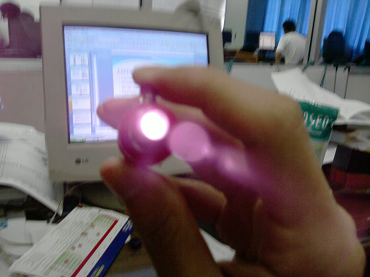
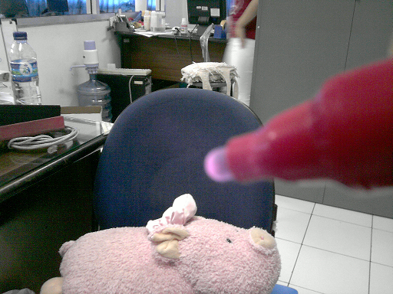
EXPERIMENTAL RESULT
Infrared LED
The infrared pen use Vishay TSAL 6400 IR
Notes:
The example we can see in this picture, the first picture is the pen is pointing to me. This is the strongest sensor infrared.
And the second picture we see the pen from the rear. The sensor is weak but it can be captured by the wiimote but not too far away.

Slide 23
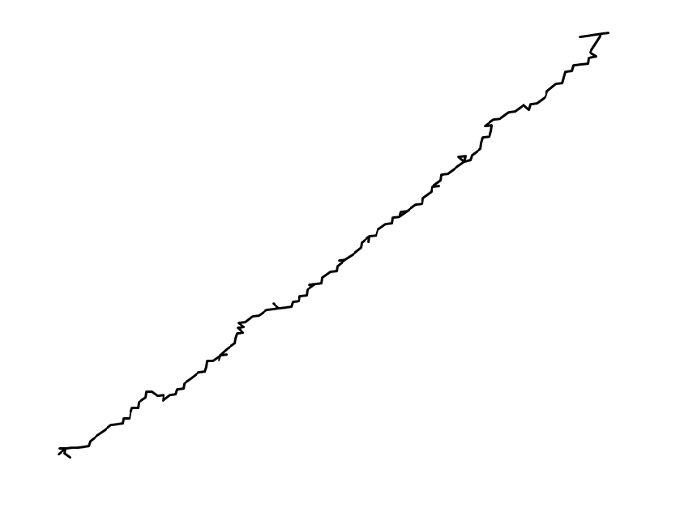
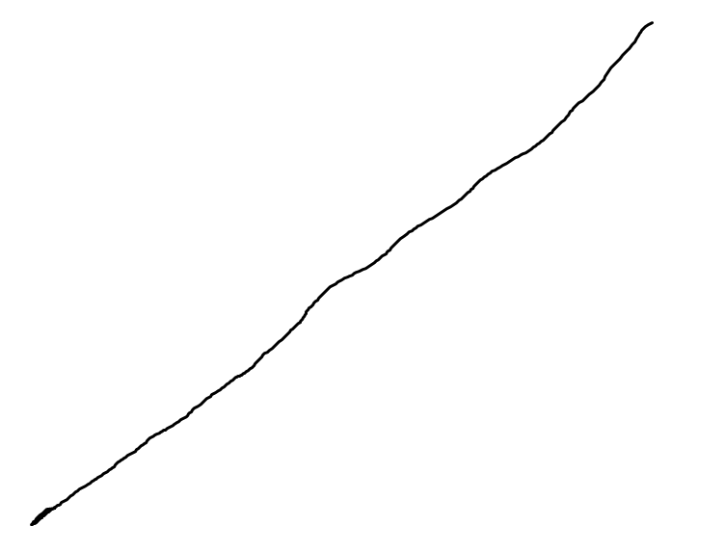
EXPERIMENTAL RESULT
Smoothing
Is used to make a smooth cursor movement
Could possible make cursor looked moves slowly
Before smoothing
After smoothing

Slide 24
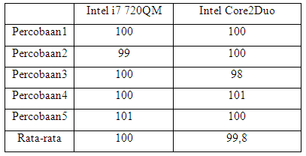
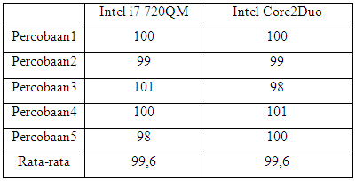
EXPERIMENTAL RESULT
Bit rate speed
The Wiimote has bit rate transfer 100 data per second
The system can process 100 data per second so there will be no missing data with Core2Duo or higher.
Bit rate transfer Wiimote
amount of data processed

Slide 25
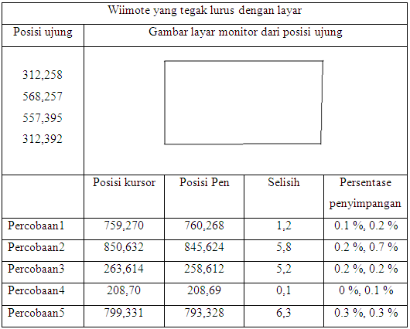
EXPERIMENTAL RESULT
Calibration result
The result of calibration is different with pen position
The results of testing calibration results with Wiimote upright position with the screen has the minimum deviation to cursor position.
Notes:
As you can see the picture inside the table is the screen shape inside the wiimote’s view

Slide 26
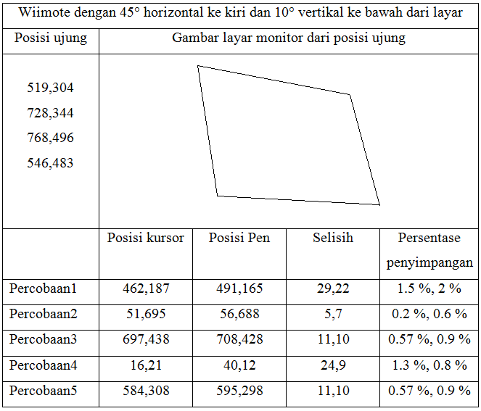
EXPERIMENTAL RESULT (cont)
Calibration test results with the Wiimote Position 10 ° Vertical downward and 45 ° horizontal to the left of the screen has the worse result in this experiment.

Slide 27
CONCLUSION
Bit rate transfer from Wiimote to computer average is 100 data per second and have high consistent.
Wiimote can’t capture sensor position accurately, so the movement of cursor becomes ugly and zig-zag.
The greater angle Wiimote to the screen will add the deviation to the cursor position with infrared pen position.
The best angle to put Wiimote is 60 degree from the screen
The reverse Bezier Curves process can’t produce an accurate graphic curve
Notes:
Well because Wiimote will be more easly to capture the sensor

Slide 28
CONCLUSION (cont)
The result of object graphic is still smooth when the object is enlarged.

Slide 29
SUGGESTION
Make a new hardware design where the Wiimote can capture the sensor even the sensor is blocked.
Develop or use another better algorithem to make a perfect result of calibration.
Use another formula or algorithem to find more accurate reverse bezier curves
Add some features like undo and redo in paint application.

Slide 30
THANKS FOR YOUR ATTENTION

