Slide 1
Website Application Security Scanner
Presenter
Deddie Tjahjono

Slide 2
AGENDA
Introduction
  Website Application Layer
  Why Web Application Security
Web Apps Security Scanner
  About
  Feature
  How it Works
Conclusion

Slide 3
Introduction

Slide 4
Website application layer
What is Website Application Layer ?
Website Application Security

Slide 5
Why web Application security
Web Apps Security Concerns
Web Security Facts

Slide 6
Web Apps Security Concerns
Bring grave security risks:
  Available 24x7x365
  Publicly available for legitimate users and hackers
  Direct access to backend databases
  Most web applications are custom-made
  These custom applications are the most susceptible to attack.
  Lack of awareness equating web security to network security.

Slide 7
Is your website hackable ?
Why Organizations Need to Worry
Who ‘s Being Hacked ?
  Choice Point Inc ($15m)
  University of Southern California ($140k +)
  Microsoft (Website defacement)
  PayPal (Account information stolen; cost unknown)
  Victoria’s Secret ($50k fine)
  Hotmail (XSS detected – not fixed)
  Amazon (XSS detected – not fixed)
  Petco (credit cards of 500k customers stolen)

Slide 8
  TJX Companies Inc
    40 million customer cards stolen
      USA, Hong Kong, Sweden, UK and Ireland.
    Lawsuits to date account for about US$ 5 to 10 million
    Government of Canada launching an investigation
    Breach probably started in 2003 and discovered in December 2006.
  Many more..
References : http://www.alliancetechpartners.com/

Slide 9
Web security facts
Gartner: 75% of Website hacks happen at the web application level.
Cisco: 95% of web applications have serious flaws,
  80% of which are vulnerable to Cross Site Scripting
Acunetix Research through Free Audits (published): 70% of sites scanned have medium to high risk vulnerabilities including:
  SQL Injection
  XSS
  Source Code Disclosure

Slide 10
The Cost of being Hacked
Closure.
Lost Customer confidence, trust and reputation.
Lost Brand equity.
Downtime.
Lost revenues and profits.
Ban on processing credit cards.
Repair the damage.
New security policies.
Legal implications including fines and damages.

Slide 11
Typical website attacks
Most Common Vulnerabilities :
  SQL Injection
  Cross-Site Scripting (XSS)
  Local File Inclusion (LFI)
  Remote File Inclusion (RFI)

Slide 12
Website Application Security Scanner
Protecting Yourself :

Slide 13
about
Audit your web applications for exploitable vulnerabilities regularly and consistently.
Three main components :
  Crawling Component
  Attacking Component
  Analysis Modules

Slide 14
Feature
Crawler (File and Website Directory)
Vulnerability Scanner
  SQL Injection
  XSS (Cross-Site Scripting)
  Local File Inclusion
  Remote File Inclusion
  Advanced SQL Injection (Union-Based for MySQL)
Possible Admin Entrance Search
Directory Listing Detection
Report Output

Slide 15
How it works
Discovery or Crawling Process Stage
Automated Scan / Attacking Stage
Reporting Stage

Slide 16
Types of vulnerability detection and methods
SQL Injection
  Error Generation
Cross-Site Scripting
  Request / Response Match
Local File Inclusion & Remote File Inclusion
Possible Admin Entrance
  Dictionary Attack
Advanced SQL Injection
  Union-Based

Slide 17
Sql injection
a code injection technique that exploits a security vulnerability occurring in the database layer of an application.
SQL Injection Types :
  Error-Based SQL Injection
  Union-Based SQL Injection
  Blind SQL Injection

Slide 18
SQL Injection types of attack
Error Based :
  Asking the DB a Question that will cause a error, and obtaining information from the error.
Union-Based :
  The SQL Union is used to combine the results of two or more SELECT SQL into a single result. Really useful for SQL Injection.
Blind :
  Asking the DB about true/false question and using whether valid page returned or not.

Slide 19
How to identify SQL Injection ?
Error Generation Method :
  By injecting the character in the original SQL request to generate a syntax error which could result in an SQL error message displayed in the HTTP reply.

Slide 20
Cross-site scripting (XSS)
Type of computer security vulnerability typically found in web applications that enables malicious attackers to inject client-side script into web pages viewed by other users.

Slide 21
How to identify Cross-site Scripting ?
Request / response match
  On every request relevant request data is matched against extracted code
  A match of given length is treated as a potential XSS attempt
  Matching is applied to code only

Slide 22
Local file inclusion (LFI) & Remote file inclusion (RFI)
Technique that allows an attacker to include a remote file usually through a script on the web server. The vulnerability occurs due to the use of user supplied input without proper validation.
Local File Inclusion :
  Allows attacker to access all the files on the server
Remote File Inclusion :
  allows attacker to include file from external servers

Slide 23
Possible admin entrance
A Feature that tries to get possible admin entrance on the target website
Use Dictionary Attack method

Slide 24
How to search possible admin entrance ?
Dictionary attack :
  technique for defeating a cipher or authentication mechanism by trying to determine its decryption key or passphrase by searching likely possibilities.
  Contrast with brute force attack, this method tries only those possibilities which are most likely to succeed

Slide 25
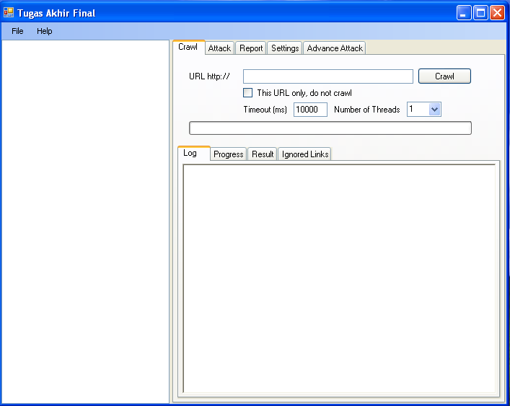
User interface
Main Interface

Slide 26
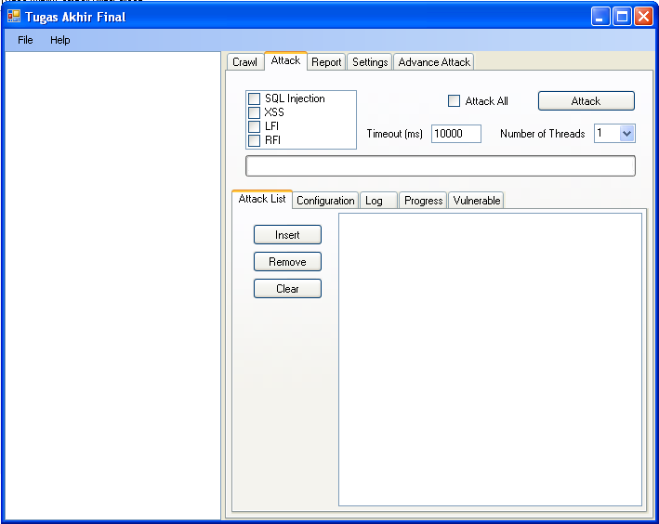
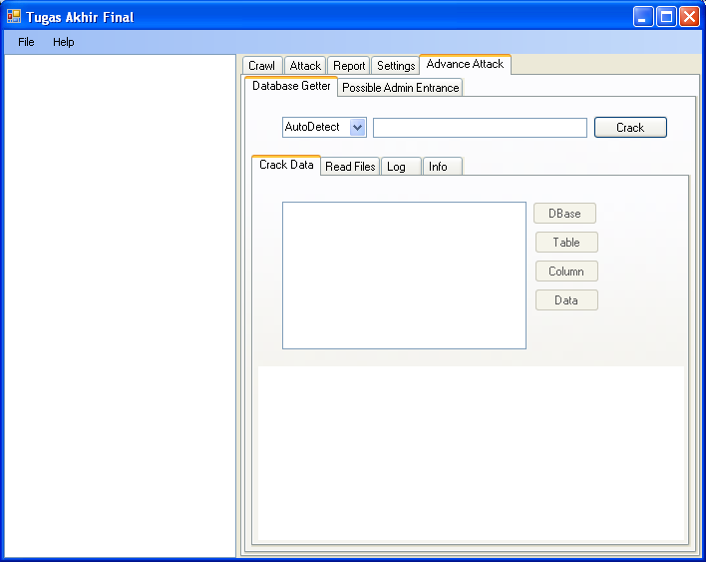
USER INTERFACE
Attacking Stage
Advanced Attack Stage

Slide 27
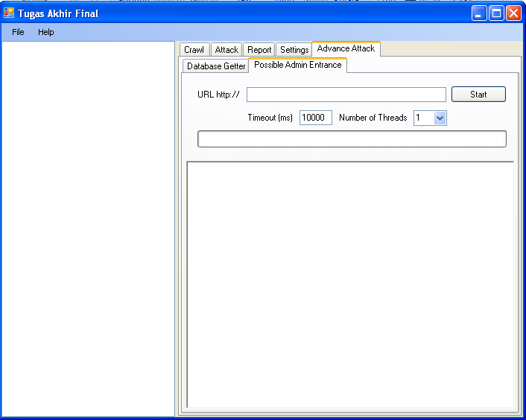
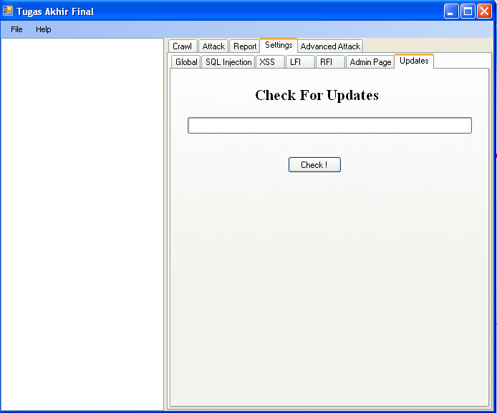
User interface
Possible Admin Entrance
Check For Updates

Slide 28
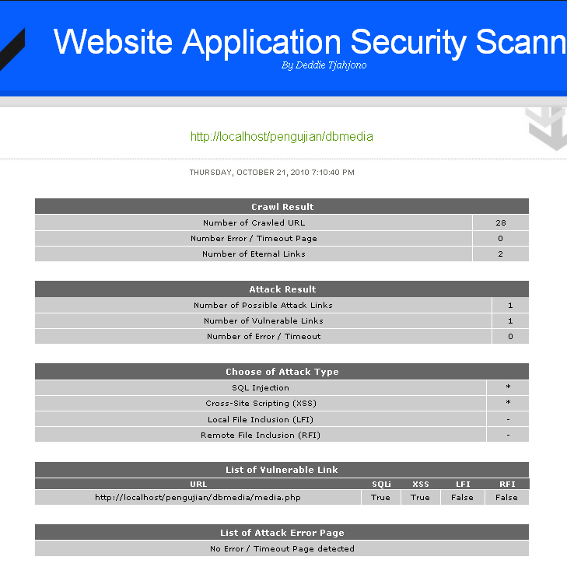
report result

Slide 29
Conclusion

Slide 30
Thank you

