Slide 1
Design and Implementation of Online Questionnaire Application for Quality Control Institute in Petra Christian University
Denny Gunawan - 26406093

Slide 2
Introduction
Background
Goals
Problems
Scope and Limitation

Slide 3
Theory
SERVQUAL
Tangible, Reliability, Responsiveness, Empathy, & Assurance
Fuzzy Set
Fuzzy Aggregation
Conjunctive, Disjunctive, Averaging Operators
Ordered Weighted Averaging (OWA) Operators

Slide 4
Administrator makes the questionnaire
Student, lecturer, & staff fill the questionnaire
Insert into the database
Administrator views the result in various ways
View in pie chart
View in Fuzzy
View in bar chart
View in SERVQUAL
View in scatter chart

Slide 5
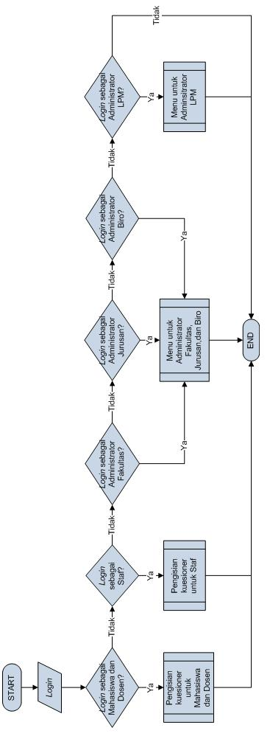
System Design
System procedure

Slide 6
System Design
Filling the questionnaire as student or lecturer

Slide 7
System Design
Filling the questionnaire as staff

Slide 8
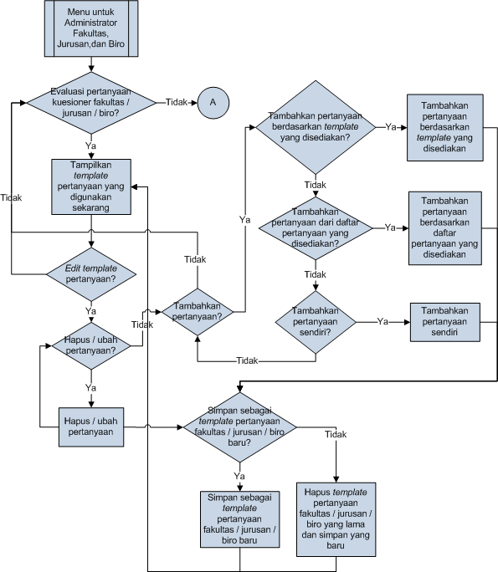
System Design
Menu to evaluate the questionnaires for Faculties, Majors, and Bureaus Administrator

Slide 9
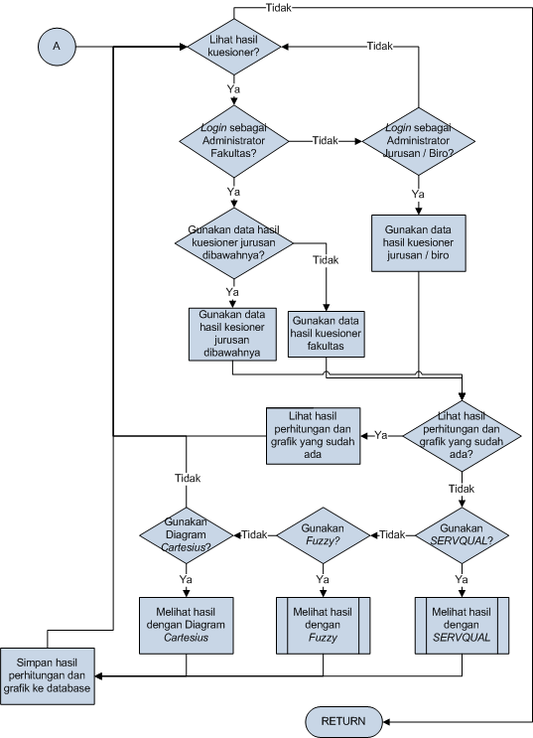
System Design (cont.)
Menu to check the result of questionnaire for Faculties, Majors, and Bureaus Administrator

Slide 10
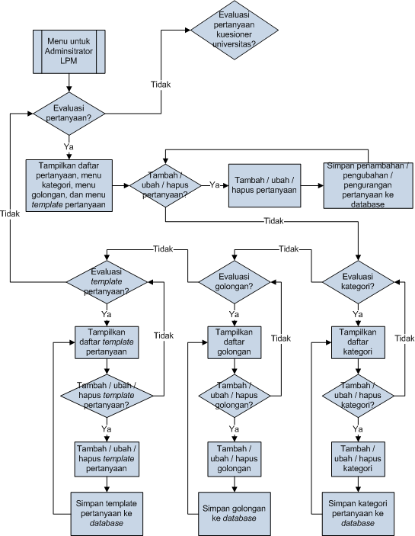
System Design (cont.)
Menu to evaluate the questions, categories, groups, and templates for Quality Control Institute Administrator

Slide 11
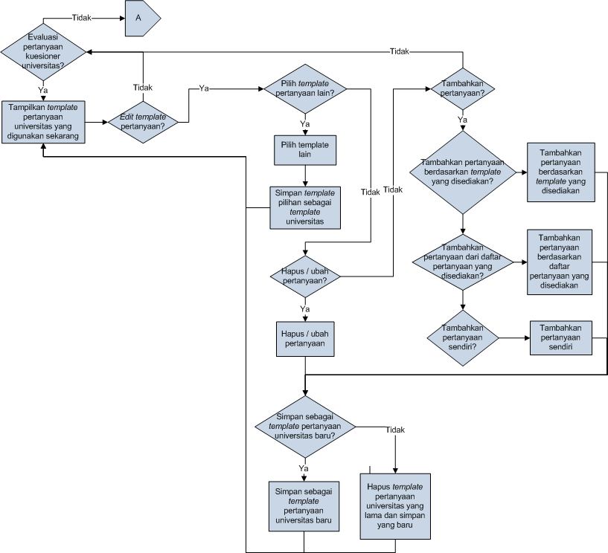
System Design (cont.)
Menu to evaluate the university questionnaire for Quality Control Institute Administrator

Slide 12
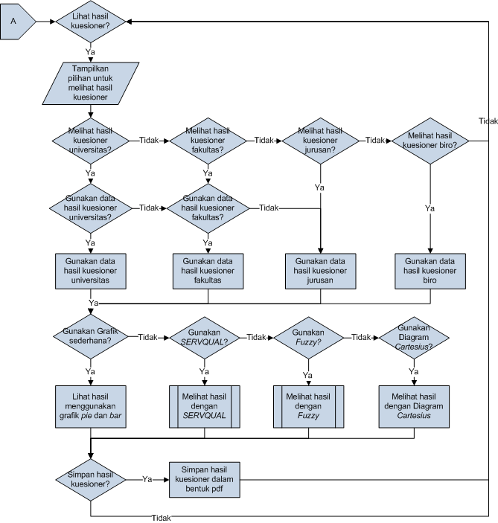
System Design (cont.)
Menu to check the result of questionnaires for Quality Control Institute Administrator

Slide 13
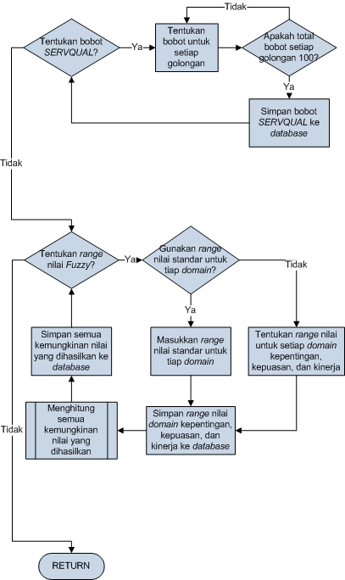
System Design (cont.)
Menu to determine the weight for SERVQUAL and range value for Fuzzy, to be used by Quality Control Institute Administrator

Slide 14
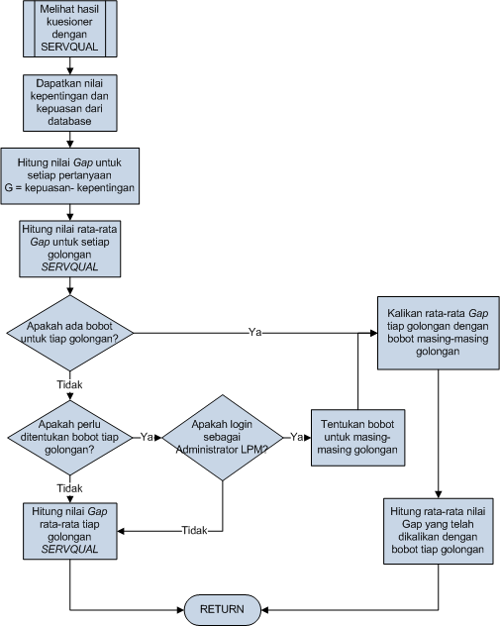
System Design (cont.)
Menu to calculate the result of the questionnaire using SERVQUAL for Quality Control Institute Administrator

Slide 15
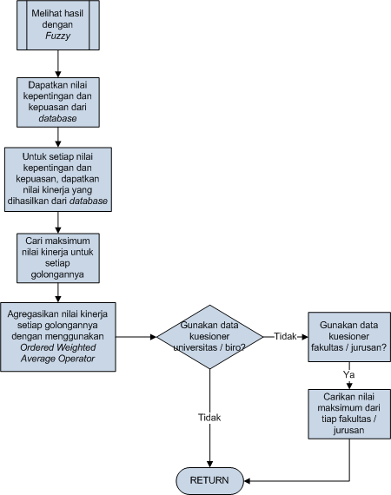
System Design (cont.)
Menu to calculate the result of the questionnaire using Fuzzy for Quality Control Institute Administrator

Slide 16
System Design (cont.)
Menu to calculate all possible output for each input using Fuzzy to be used by Quality Control Institute Administrator

Slide 17
System Design (cont.)
System design using Data Flow Diagram (Context Diagram)

Slide 18
System Design (cont.)
System design using Data Flow Diagram (Level 0 Diagram)

Slide 19
System Design (cont.)
System design using Data Flow Diagram (Level 1 Diagram)

Slide 20
System Design (cont.)
Design system using Entity Relationship Diagram

Slide 21
System Design (cont.)
Physical Database
Tabel_biro
Tabel_Calc_Fuzzy
Nama Field | Tipe Data | Keterangan
Kode_Biro* | VARCHAR(10) | Kode biro
Nama_Biro | VARCHAR(50) | Nama Biro
Nama Field | Tipe Data | Keterangan
Nilai_Kepentingan* | FLOAT | Kode biro
Nilai_Kepuasan* | FLOAT | Nama Biro
Hasil | FLOAT | Hasil Kinerja

Slide 22
System Design (cont.)
Tabel_Dosen
Tabel_Fakultas
Nama Field | Tipe Data | Keterangan
NIP* | VARCHAR(10) | NIP dosen
Nama_Dosen | VARCHAR(50) | Nama Dosen
Kode_Jurusan | VARCHAR(10) | Kode Jurusan
Nama Field | Tipe Data | Keterangan
Kode_Fakultas* | VACHAR(10) | Kode Fakultas
Nama_Fakultas | VARCHAR(50) | Nama Fakultas
Kode_Template | VARCHAR(10) | Kode template yang digunakan fakultas

Slide 23
System Design (cont.)
Tabel_Fuzzy
Nama Field | Tipe Data | Keterangan
Domain* | VACHAR(20) | Daerah hasil
Nilai1 | FLOAT | Nilai membership 1
Nilai2 | FLOAT | Nilai membership 2
Nilai3 | FLOAT | Nilai membership 3
Nilai4 | FLOAT | Nilai membership 4
Nilai5 | FLOAT | Nilai membership 5
Nilai6 | FLOAT | Nilai membership 6 (untuk daerah hasil kinerja)
Nilai7 | FLOAT | Nilai membership 7 (untuk daerah hasil kinerja)
Nilai8 | FLOAT | Nilai membership 8 (untuk daerah hasil kinerja)
Nilai9 | FLOAT | Nilai membership 9 (untuk daerah hasil kinerja)
Nilai10 | FLOAT | Nilai membership 10 (untuk daerah hasil kinerja)
Nilai11 | FLOAT | Nilai membership 11 (untuk daerah hasil kinerja)
Nilai12 | FLOAT | Nilai membership 12 (untuk daerah hasil kinerja)
Nilai13 | FLOAT | Nilai membership 13 (untuk daerah hasil kinerja)

Slide 24
System Design (cont.)
Tabel_Golongan
Tabel_Hasil
Nama Field | Tipe Data | Keterangan
Kode_Golongan* | VARCHAR(10) | Kode golongan
Golongan | VARCHAR(20) | Nama golongan
Keterangan | VARCHAR(100) | Keterangan golongan
Nama Field | Tipe Data | Keterangan
ID_Pertanyaan | INTEGER | ID_Pertanyaan
Kepentingan | INTEGER | Nilai kepentingan
Kepuasan | INTEGER | Nilai kepuasan
Tanggal pengisian | DATETIME | Tanggal input
Kode_Unit | VARCHAR(12) | Kode unit kuesioner yang diisi
Pengisi | VARCHAR (100) | ID Pengisi (dirahasiakan)

Slide 25
System Design (cont.)
Tabel_Isi_Template
Tabel_Jurusan
Nama Field | Tipe Data | Keterangan
Kode_Template | VARCHAR(10) | Kode template
ID_Pertanyaan | INTEGER | ID pertanyaan
Nama Field | Tipe Data | Keterangan
Kode_Jurusan* | VARCHAR(10) | Kode jurusan
Nama_Jurusan | VARCHAR(50) | Nama jurusan
Kode_Fakultas | VARCHAR(10) | Kode fakultas
Kode_Template | VARCHAR(10) | Kode template yang digunakan jurusan

Slide 26
System Design (cont.)
Tabel_Kategori
Tabel_Fakultas
Nama Field | Tipe Data | Keterangan
Kode_Kategori* | VARCHAR(10) | Kode kategori
Kategori | VARCHAR(100) | Nama kategori
Keterangan | VARCHAR(100) | Keterangan kategori
Nama Field | Tipe Data | Keterangan
NRP* | VARCHAR(8) | NRP mahasiswa
Nama_Mahasiswa | VARCHAR(50) | Nama mahasiswa
Kode_Jurusan | VARCHAR(10) | Kode jurusan
Pass | VARCAR(50) | Password mahasiswa (dirahasiakan)

Slide 27
System Design (cont.)
Tabel_Pertanyaan
Nama Field | Tipe Data | Keterangan
Kode_Pertanyaan* | VARCHAR(10) | Kode pertanyaan
Pertanyan | VARCHAR(100) | Pertanyaan
Kode_Kategori | VARCHAR(10) | Kode kategori
No_Kategori | INTEGER | Nomer kategori
Kode_Golongan | VARCHAR(10) | Kode golongan

Slide 28
System Design (cont.)
Tabel_Staf
Tabel_Template
Nama Field | Tipe Data | Keterangan
NIP* | VARCHAR(10) | NIP staf
Nama | VARCHAR(50) | Nama staf
Kode_Biro | VARCHAR(10) | Kode biro
Pass | VARCHAR(50) | Password staf
Nama Field | Tipe Data | Keterangan
Kode_Template* | VARCHAR(10) | Kode template
Keterangan | VARCHAR(300) | Keterangan template
Status_Aktif | VARCHAR(10) | Status aktivasi template

Slide 29
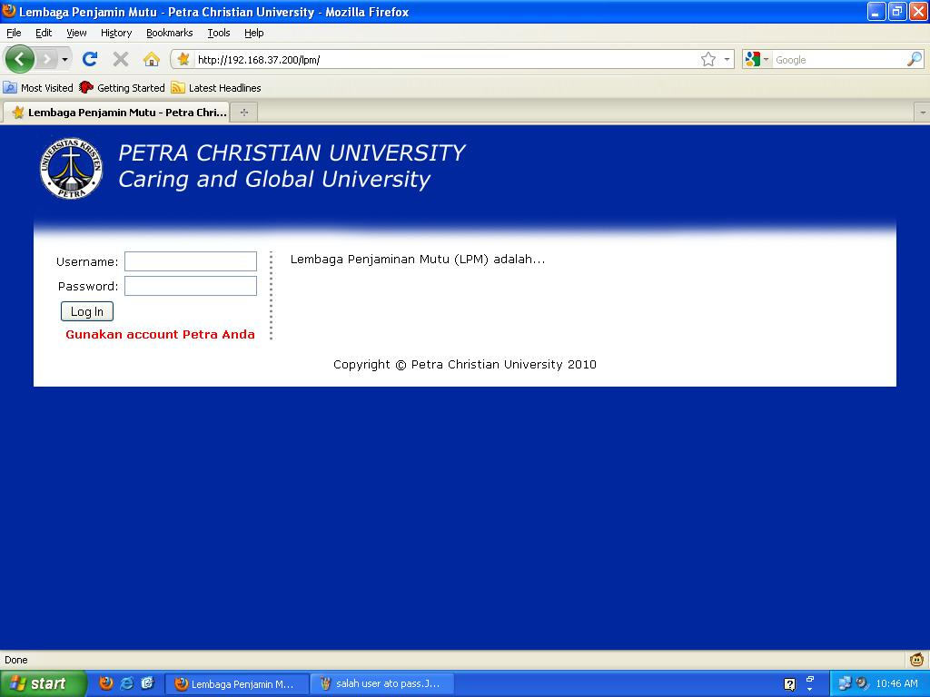
System Trial
Login Page

Slide 30
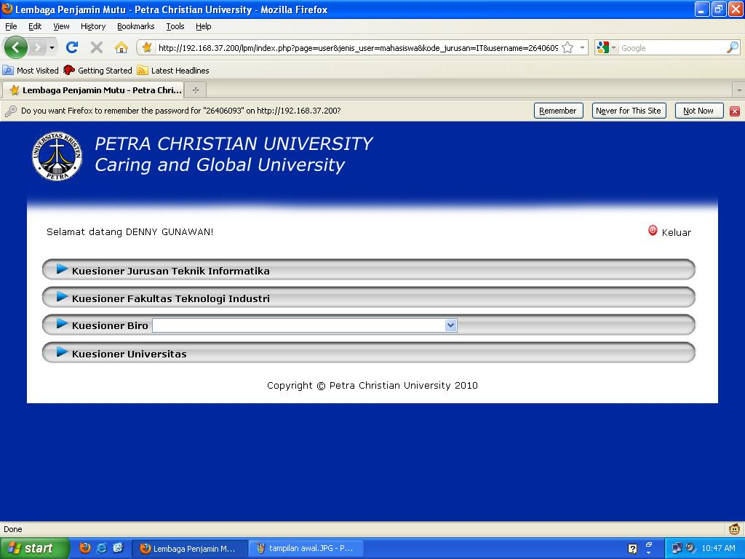
System Trial (cont.)
Filling the questionnaire by student or lecturer (1)

Slide 31
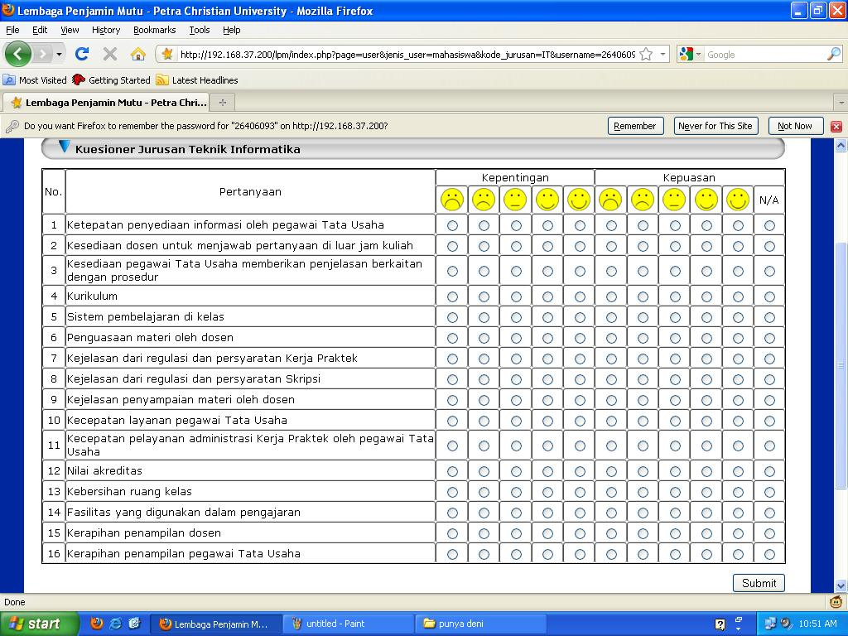
System Trial (cont.)
Filling the questionnaire by student or lecturer (2)

Slide 32
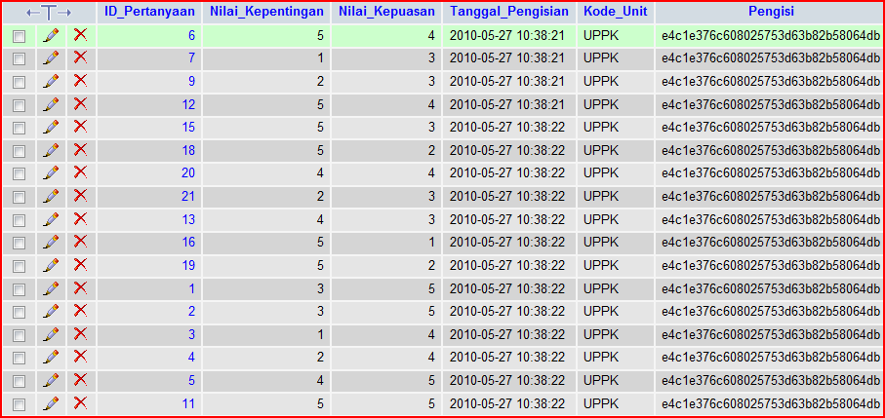
System Trial (cont.)
Store the result of the questionnaire into the database

Slide 33
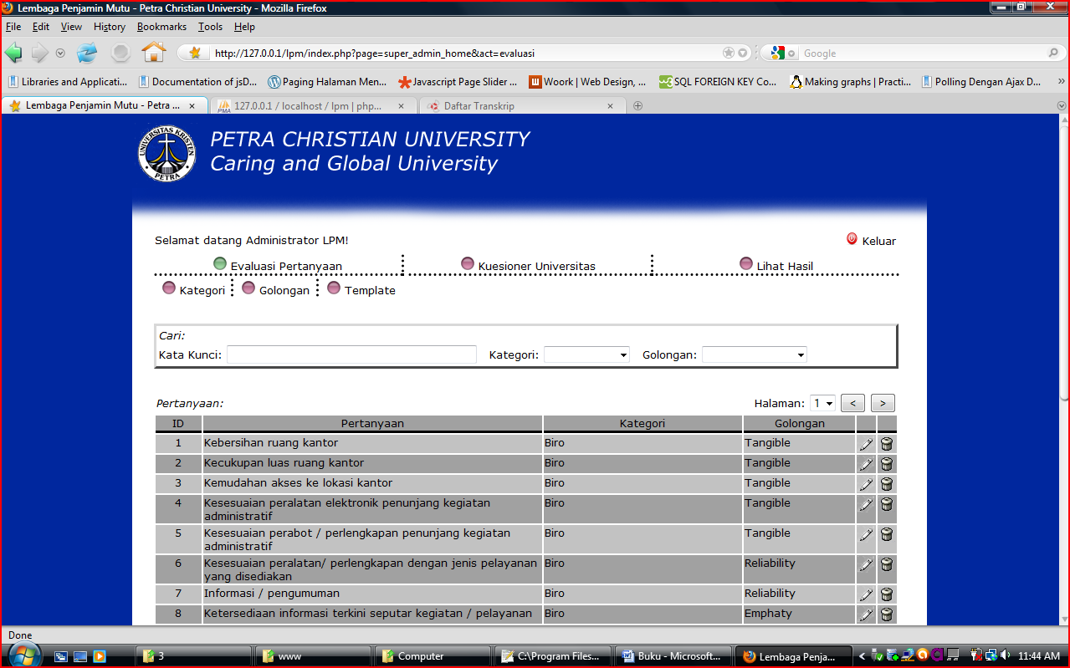
System Trial (cont.)
Evaluating the questions by Quality Control Institute Administrator

Slide 34
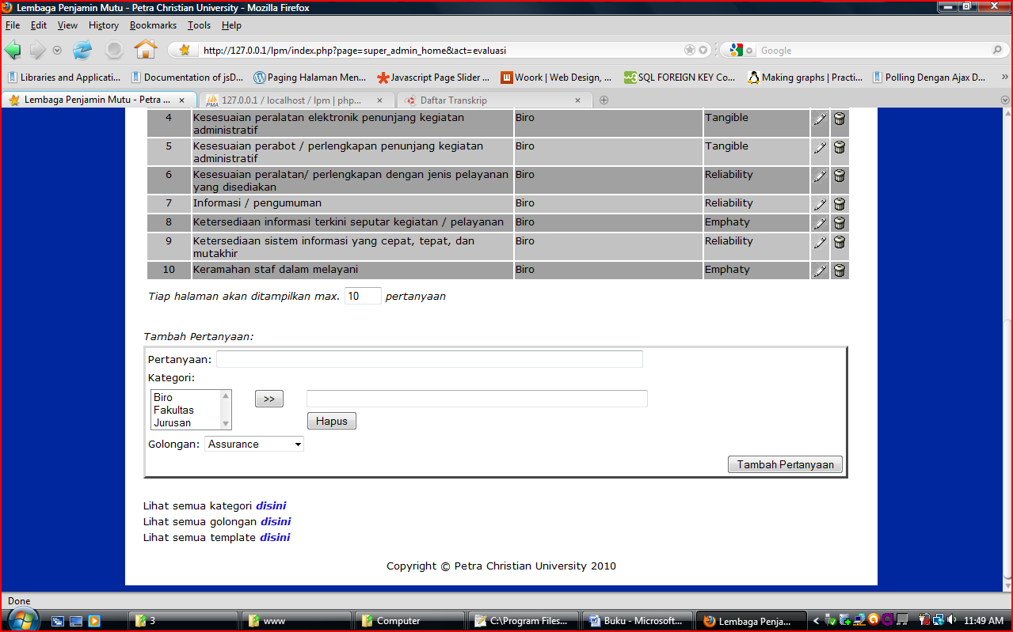
System Trial (cont.)
Adding question by Quality Control Institute Administrator

Slide 35
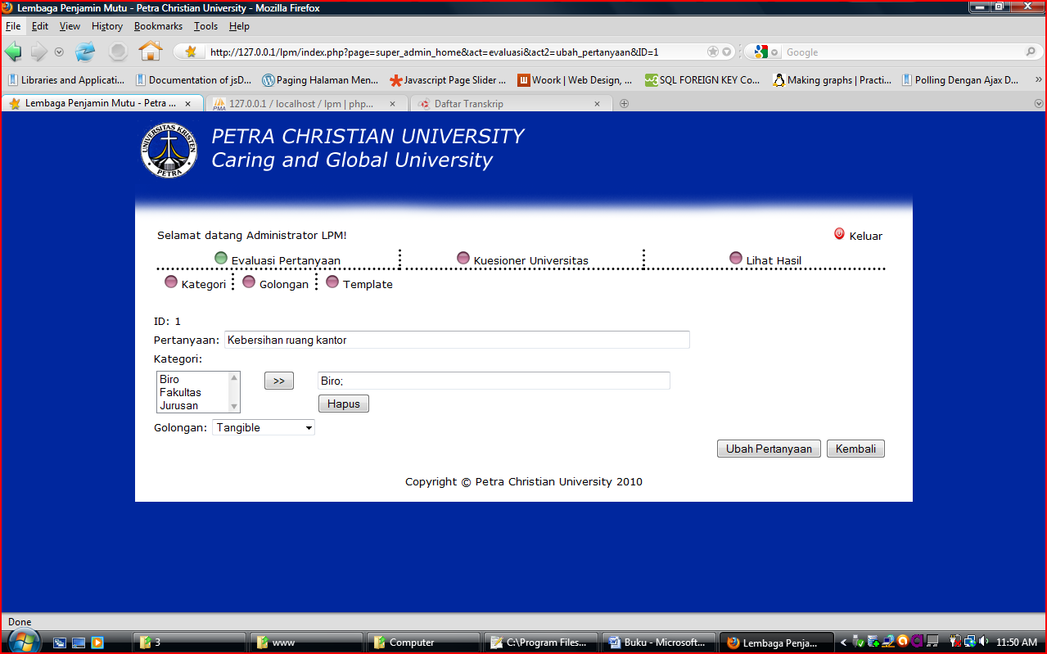
System Trial (cont.)
Changing question by Quality Control Institute Administrator

Slide 36
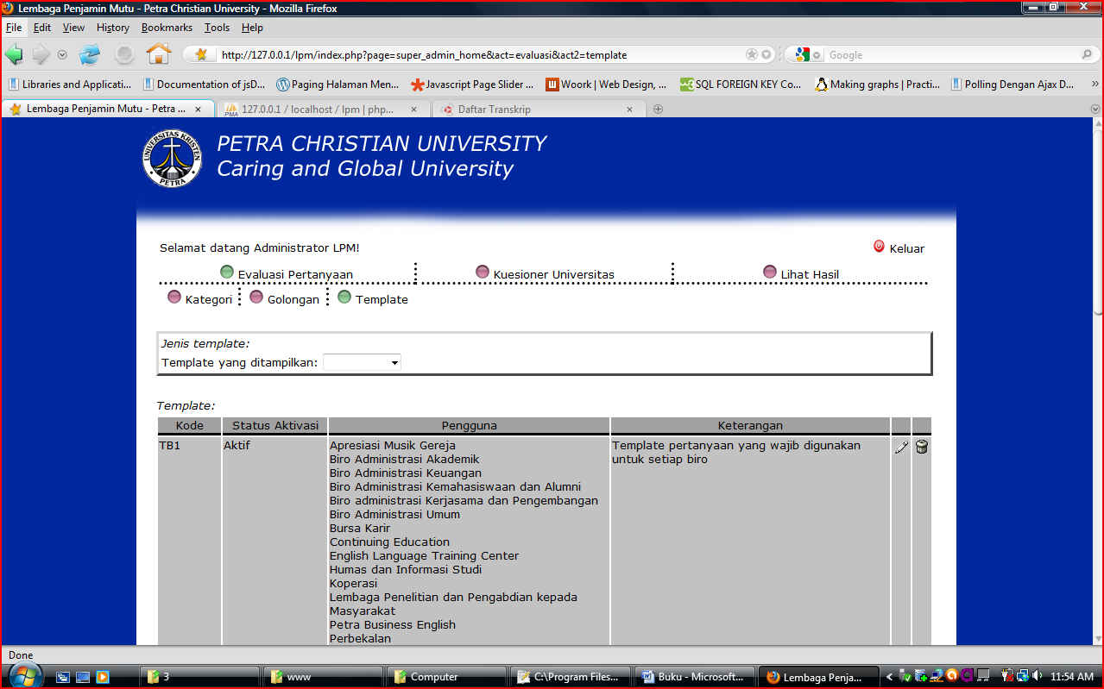
System Trial (cont.)
Evaluating template by Quality Control Institute

Slide 37
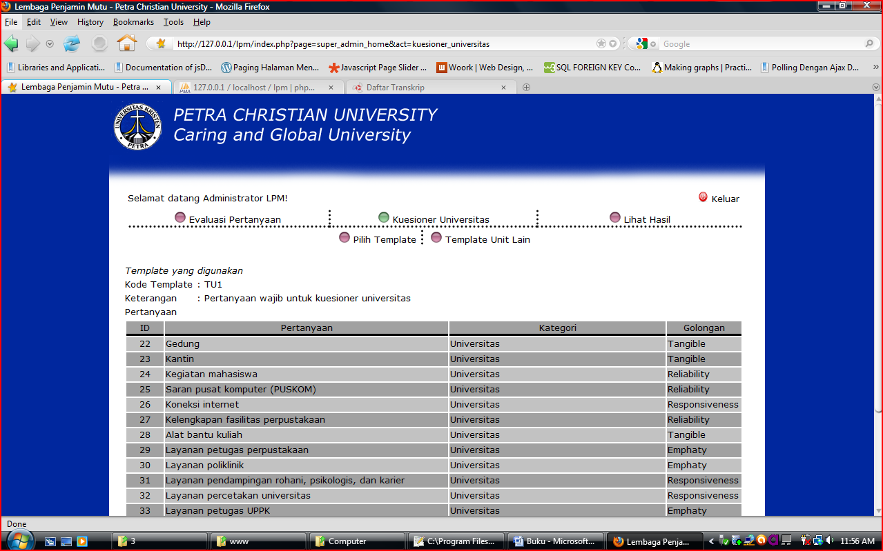
System Trial (cont.)
Showing university questionnaire

Slide 38
System Trial (cont.)
Show template used in university questionnaire

Slide 39
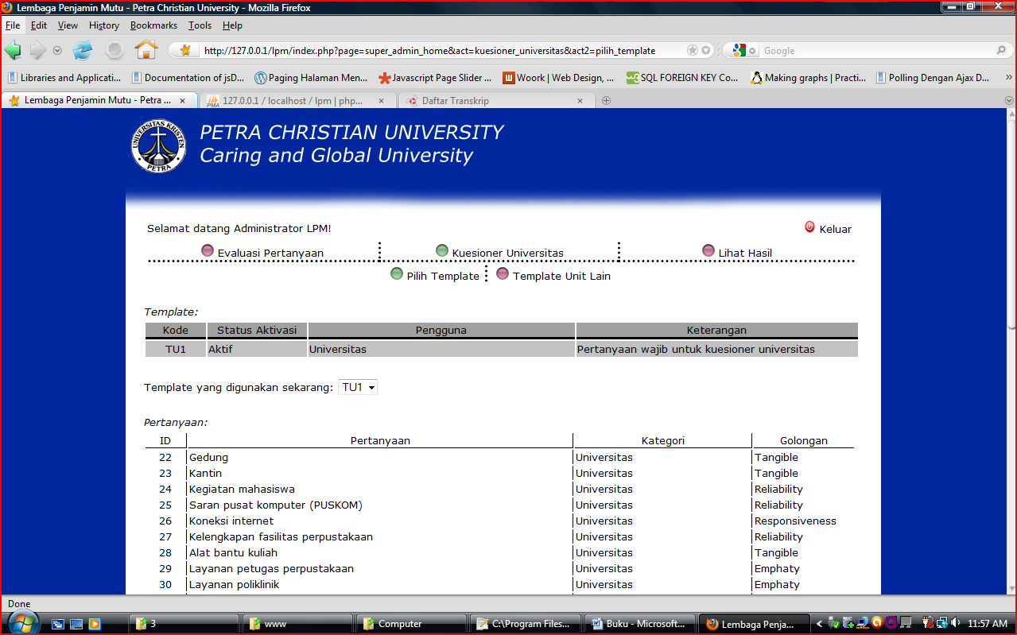
System Trial (cont.)
Choose template to be used in university questionnaire

Slide 40
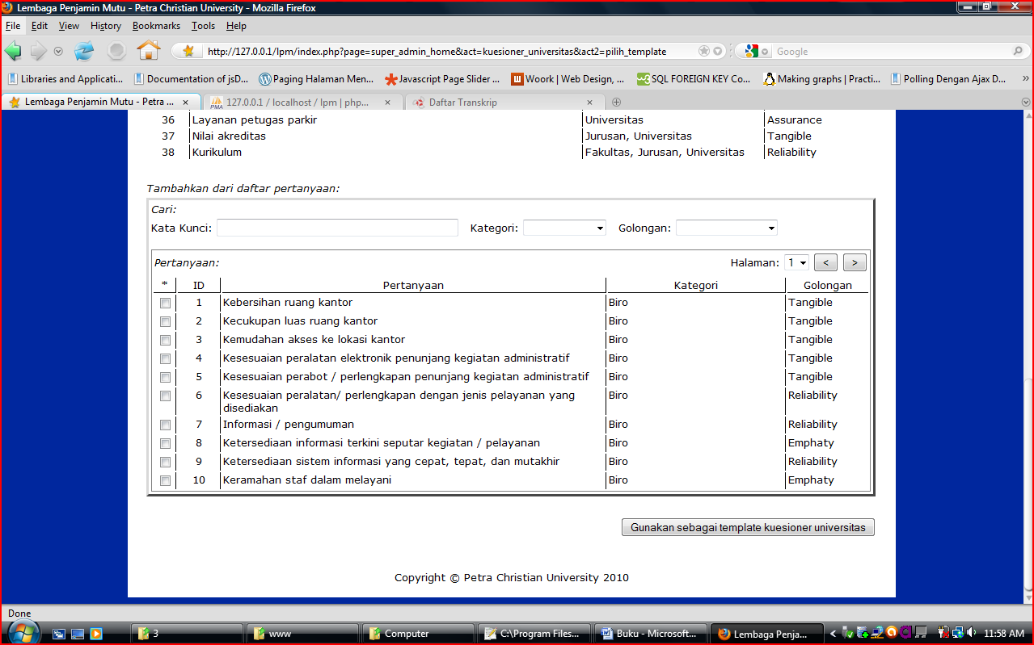
System Trial (cont.)
Choose questions to be used in university questionnaire without using template

Slide 41
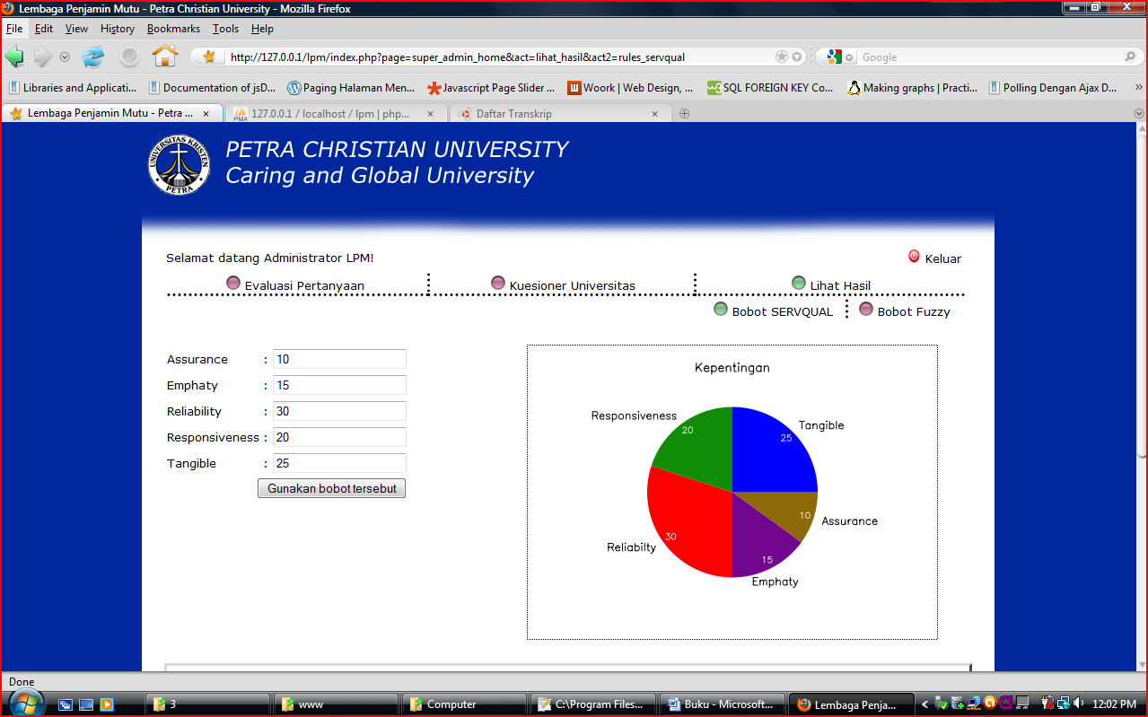
System Trial (cont.)
Determine the weight for each SERVQUAL dimension

Slide 42
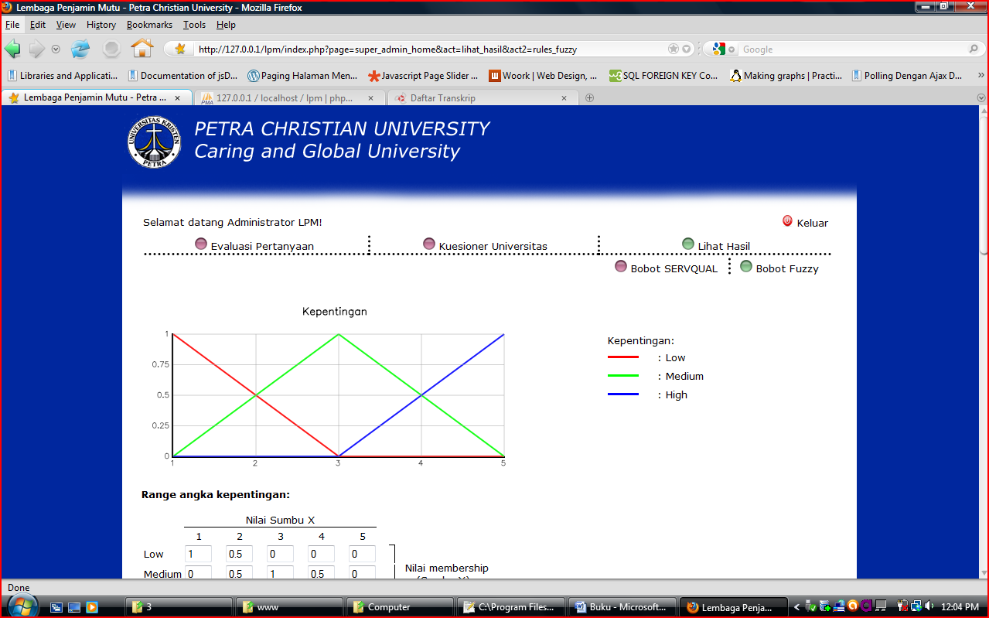
System Trial (cont.)
Determine the range values for Fuzzy (1)

Slide 43
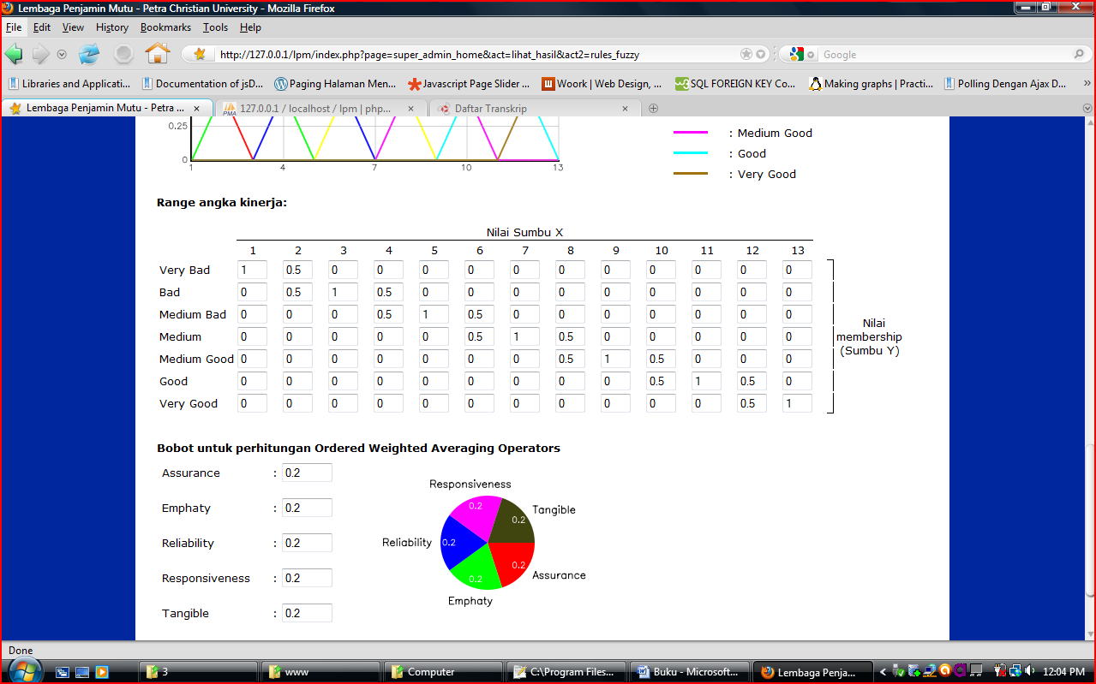
System Trial (cont.)
Determine the range values for Fuzzy (2)

Slide 44
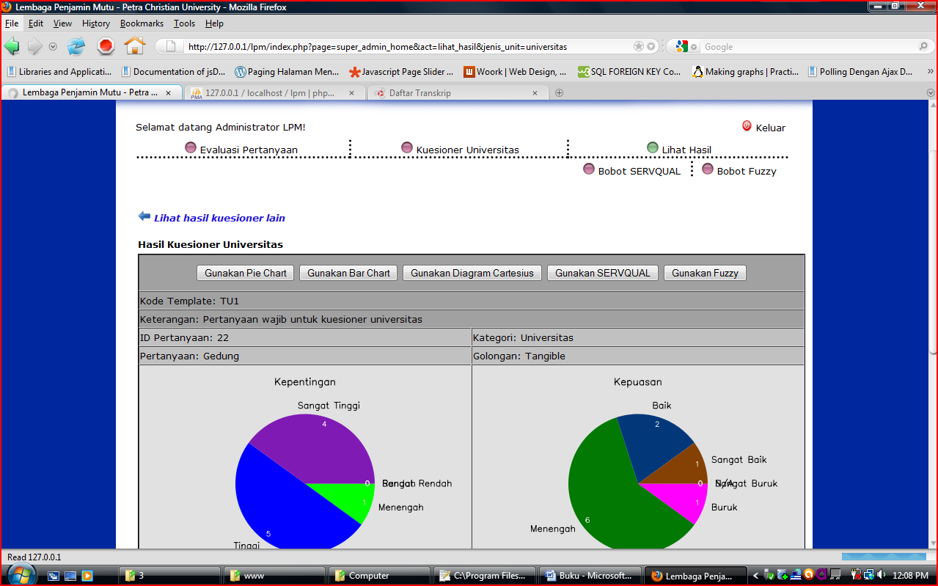
System Trial (cont.)
Show the result using pie chart

Slide 45
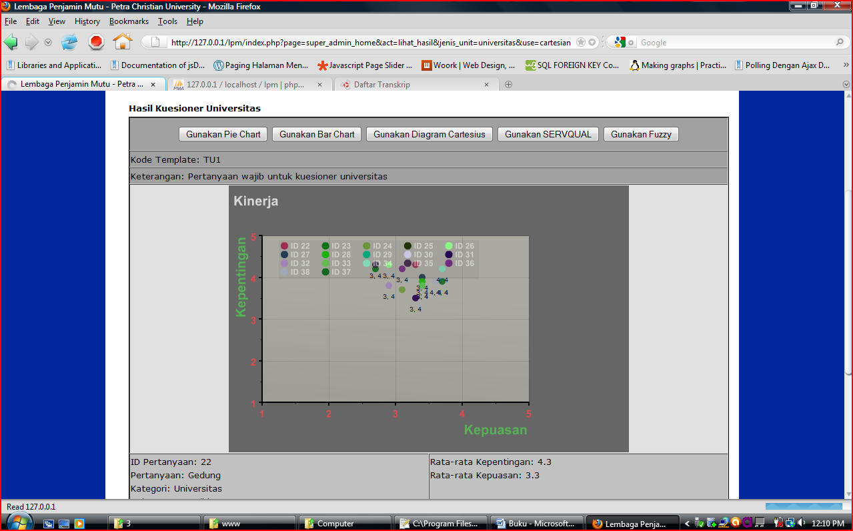
System Trial (cont.)
Show the result using cartesius diagram

Slide 46
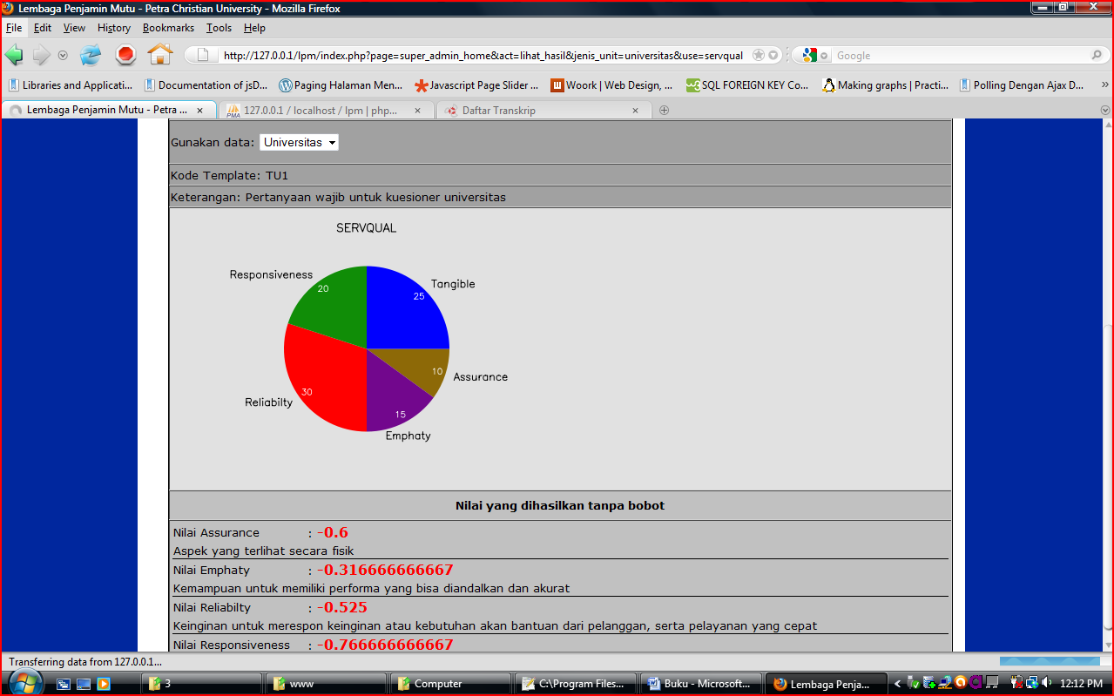
System Trial (cont.)
Show the result using SERVQUAL

Slide 47
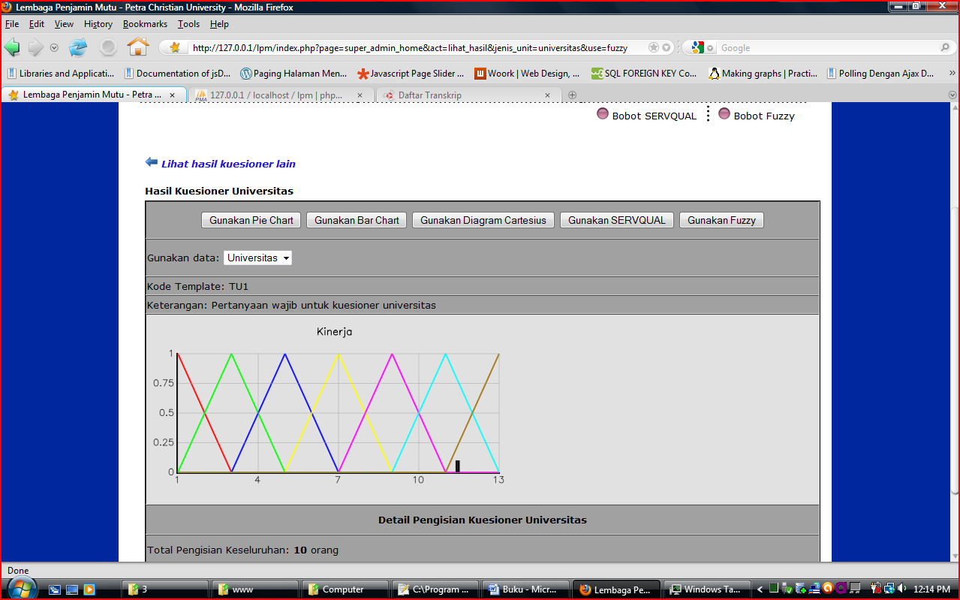
System Trial (cont.)
Show the result using FUZZY

