Slide 1
Planning and Application Design Development for Prodution Planning and Inventory Control in Balatif Company
Andy Tendean - 26407098
Notes:
Good afternoon my examiner and my adviser
My name is andy and now I want to present my thesis
Planning and application design development for production planning and inventory control in balatif company

Slide 2
Background
Balatif is a company which runs in medicine business.
Balatif sell medicine especially herbal medicine and supplement.
Balatif using human decision for decide sales for next period.
This company often lack good stock and determine the amount of the raw material.

Slide 3
Research Problem
How to make forecasting system using Moving Average, Trend Linear, Winter, Exponential Smoothing, and Double Exponential.
How to make Master Production Scheduling system and Material Requirements Planning system with lot sizing considerate using Lot-for-lot, Fixed Order Quantity, Fixed Order Period, Silver Meal, Least Unit Cost, Part Period Balancing, and Wagner Within.
How to help Balatif to give information about how many raw material needed in the next period

Slide 4
Thesis Goal
To make forecasting and scheduling system for Balatif company for help give information about how many raw material needed in the next period.

Slide 5
Scope
Input from Balatif company sales for 2 years
Increase from thesis “Design and Making of Calculation Cost of Goods Manufactured System for Pharmaceutical Products at PT. Balatif with Process Costing Method” in form of calculation raw material.
Get stock data, user data, product data and Bill of Material data from thesis “Design and Making of Calculation Cost of Goods Manufactured System for Pharmaceutical Products at PT. Balatif with Process Costing Method”

Slide 6
Scope(cont.)
Forecasting method using Moving Average, Trend Linear, Winter, Exponential Smoothing, and Double Exponential Smoothing.
Error method using Average Error, Mean Absolute Deviation, Mean Squared Error, and Mean Absolute Percentage Error.
Have MPS and MRP features.
Lot sizing method using Lot-for-lot, Fixed Order Quantity, Fixed Order Period, Silver Meal, Least Unit Cost, Part Period Balancing, and Wagner Within.

Slide 7
Scope(cont.)
Output in form of information how many raw material needed in the next period.
Application created using Microsoft Visual Studio .Net 2005.
The database using Oracle 10g.

Slide 8
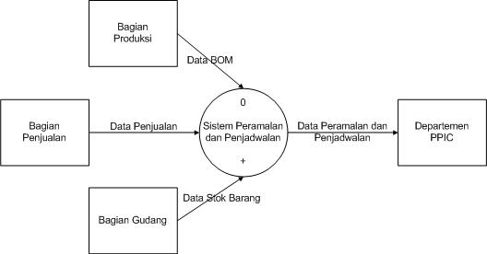
System Design
Data Flow Diagram (DFD)
Contextual Diagram(page 25)

Slide 9
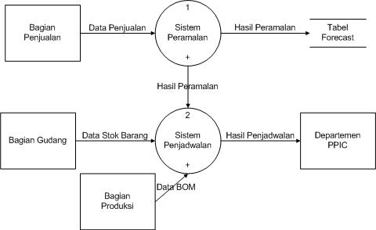
DFD Level 0 (page 26)

Slide 10
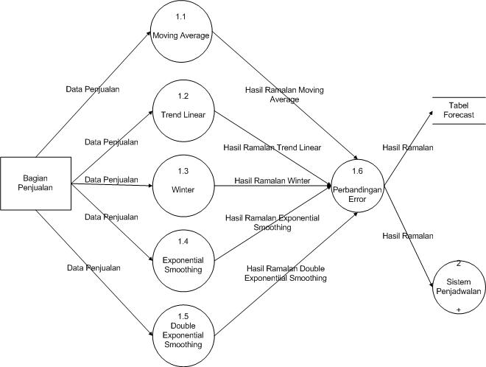
DFD Level 1 (page 26)

Slide 11
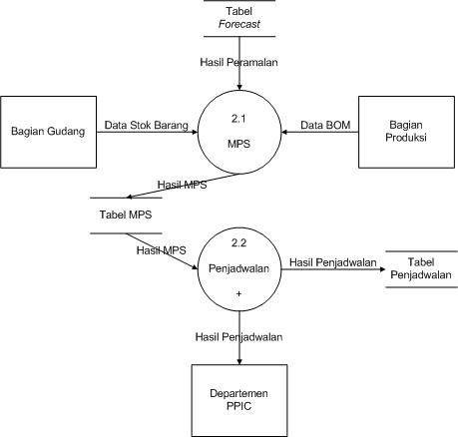
DFD Level 2 (page 27)

Slide 12
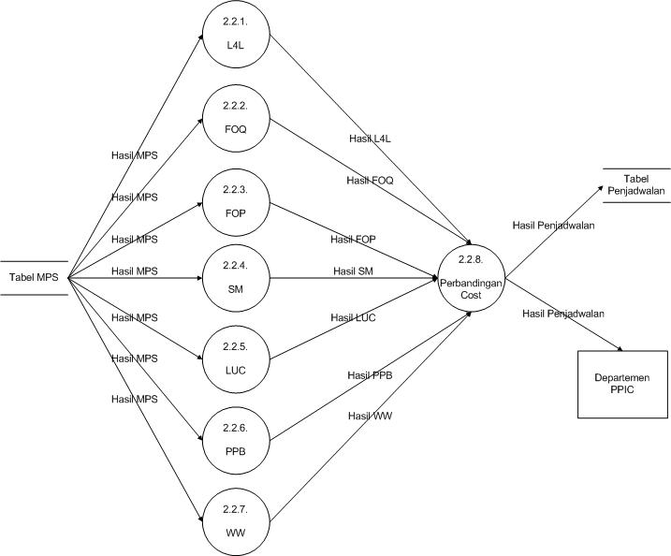
DFD Level 2.2.1 (page 28)

Slide 13
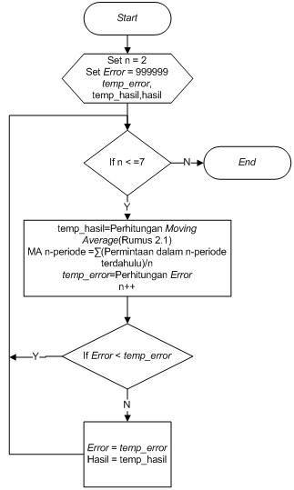
Flowchart Forecasting
Moving Average(page 29)

Slide 14
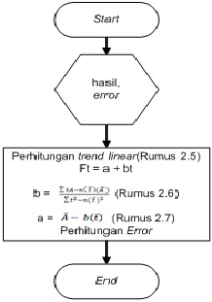
Flowchart Forecasting(cont.)
Trend Linear(page 30)

Slide 15
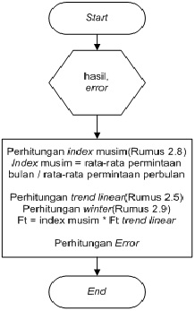
Flowchart Forecasting(cont.)
Winter(page 30)

Slide 16
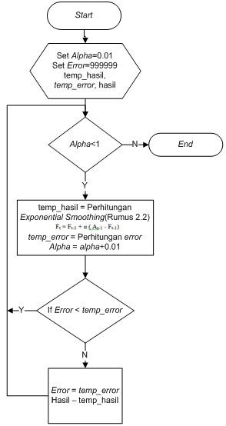
Flowchart Forecasting(cont.)
Exponential Smoothing
(page 31)

Slide 17
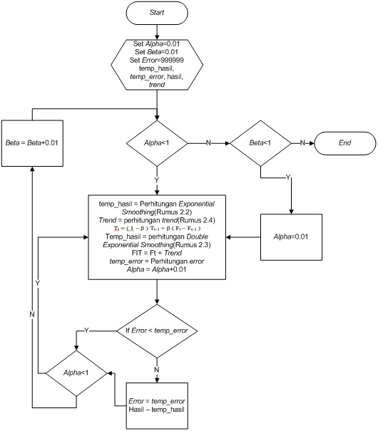
Flowchart Forecasting(cont.)
Double Exponential
Smoothing(page 32)

Slide 18
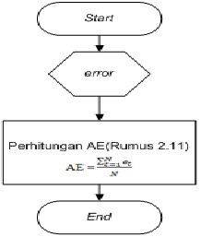
Flowchart Error
Average Error(page 33)

Slide 19
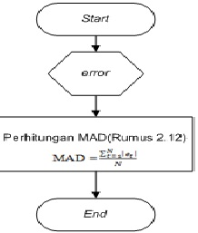
Flowchart Error(cont.)
Mean Absolute Deviation
(page 33)

Slide 20
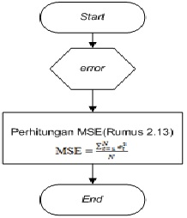
Flowchart Error(cont.)
Mean Squared Error
(page 34)

Slide 21
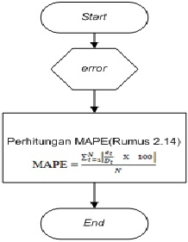
Flowchart Error(cont.)
Mean Absolute Percentage
Error(page 34)

Slide 22
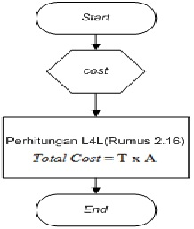
Flowchart Lot Sizing
Lot-For-Lot(page 35)

Slide 23
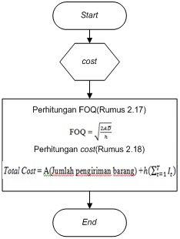
Flowchart Lot Sizing(cont.)
Fixed Order Quantity
(page 35)

Slide 24
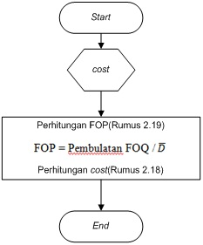
Flowchart Lot Sizing(cont.)
Fixed Order Period
(page 36)

Slide 25
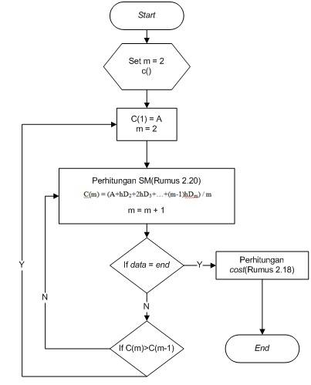
Flowchart Lot Sizing(cont.)
Silver Meal(page 37)

Slide 26
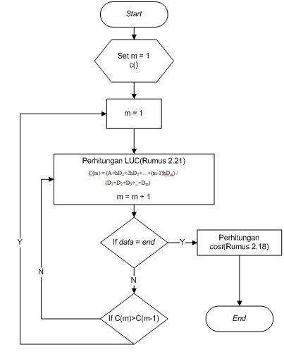
Flowchart Lot Sizing(cont.)
Least Unit Cost
(page 38)

Slide 27
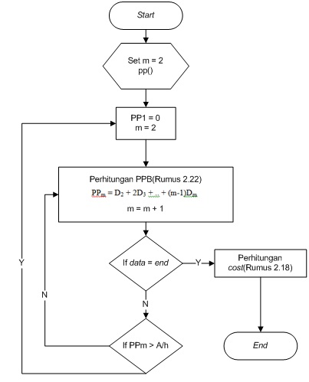
Flowchart Lot Sizing(cont.)
Past Period Balancing
(page 39)

Slide 28
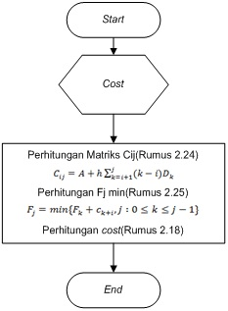
Flowchart Lot Sizing(cont.)
Wagner Within(page 40)

Slide 29
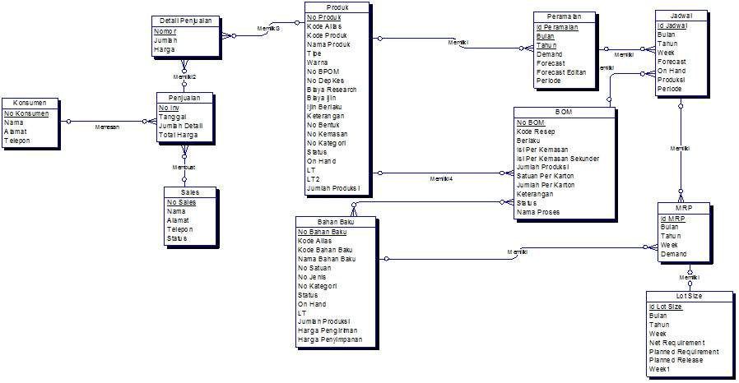
ERD Conceptual(page 41)

Slide 30
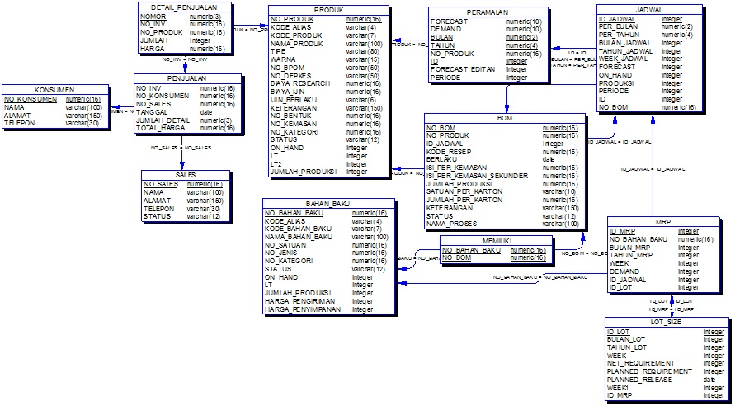
ERD Physical(page 42)

Slide 31
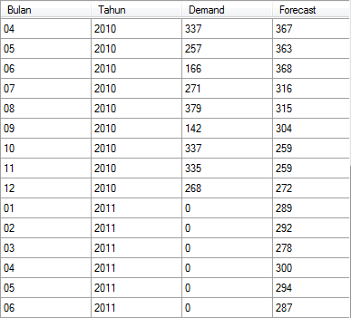
Experiment
Arkavit Tablet Strip 10/10 Ungu

Slide 32
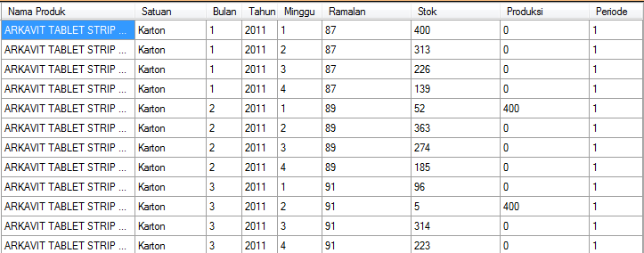
Experiment(cont.)
Arkavit Tablet Strip 10/10 Ungu

Slide 33
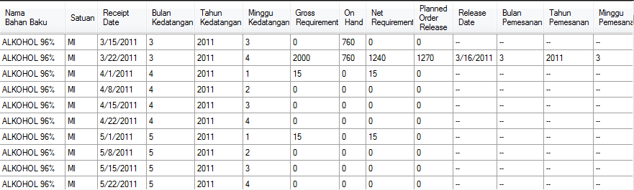
Experiment(cont.)
Alkohol 96%

Slide 34
Conclusion
This application is match with Moving Average, Trend Linear, Winter, Exponential Smoothing, and Double Exponential Smoothing.
This application can give information about sales order that will happen in the next period.

Slide 35
Conclusion(cont.)
This application is match with Lot-for-lot, Fixed Order Quantity, Fixed Order Period, Silver Meal, Least Unit Cost, Part Period Balancing, and Wagner Within.
The result from validation testing showed the calculation of this application is match with manual’s calculation.
This application can give information about raw material needed in the next period.

Slide 36
Conclusion(cont.)
From the result of questionnaire, we know that overall the program is consider good by the respondent.

Slide 37
Suggestion
This application can be developed with using ARIMA method.
This application can be developed with using daily scheduling.

Slide 38
Thank You for Your Attention

